Slide 1
Evaluating a Big Data Platform and the Role of a Work-From-Home Component in Travel Demand Model Calibration
Paris Charitatos, Dahai Han

Slide 2
Contents
Motivation
Key Questions
Data Sources
Methodology I: Big Data Analysis
Methodology II: WFH Testing in TDM23
Conclusions

Slide 3
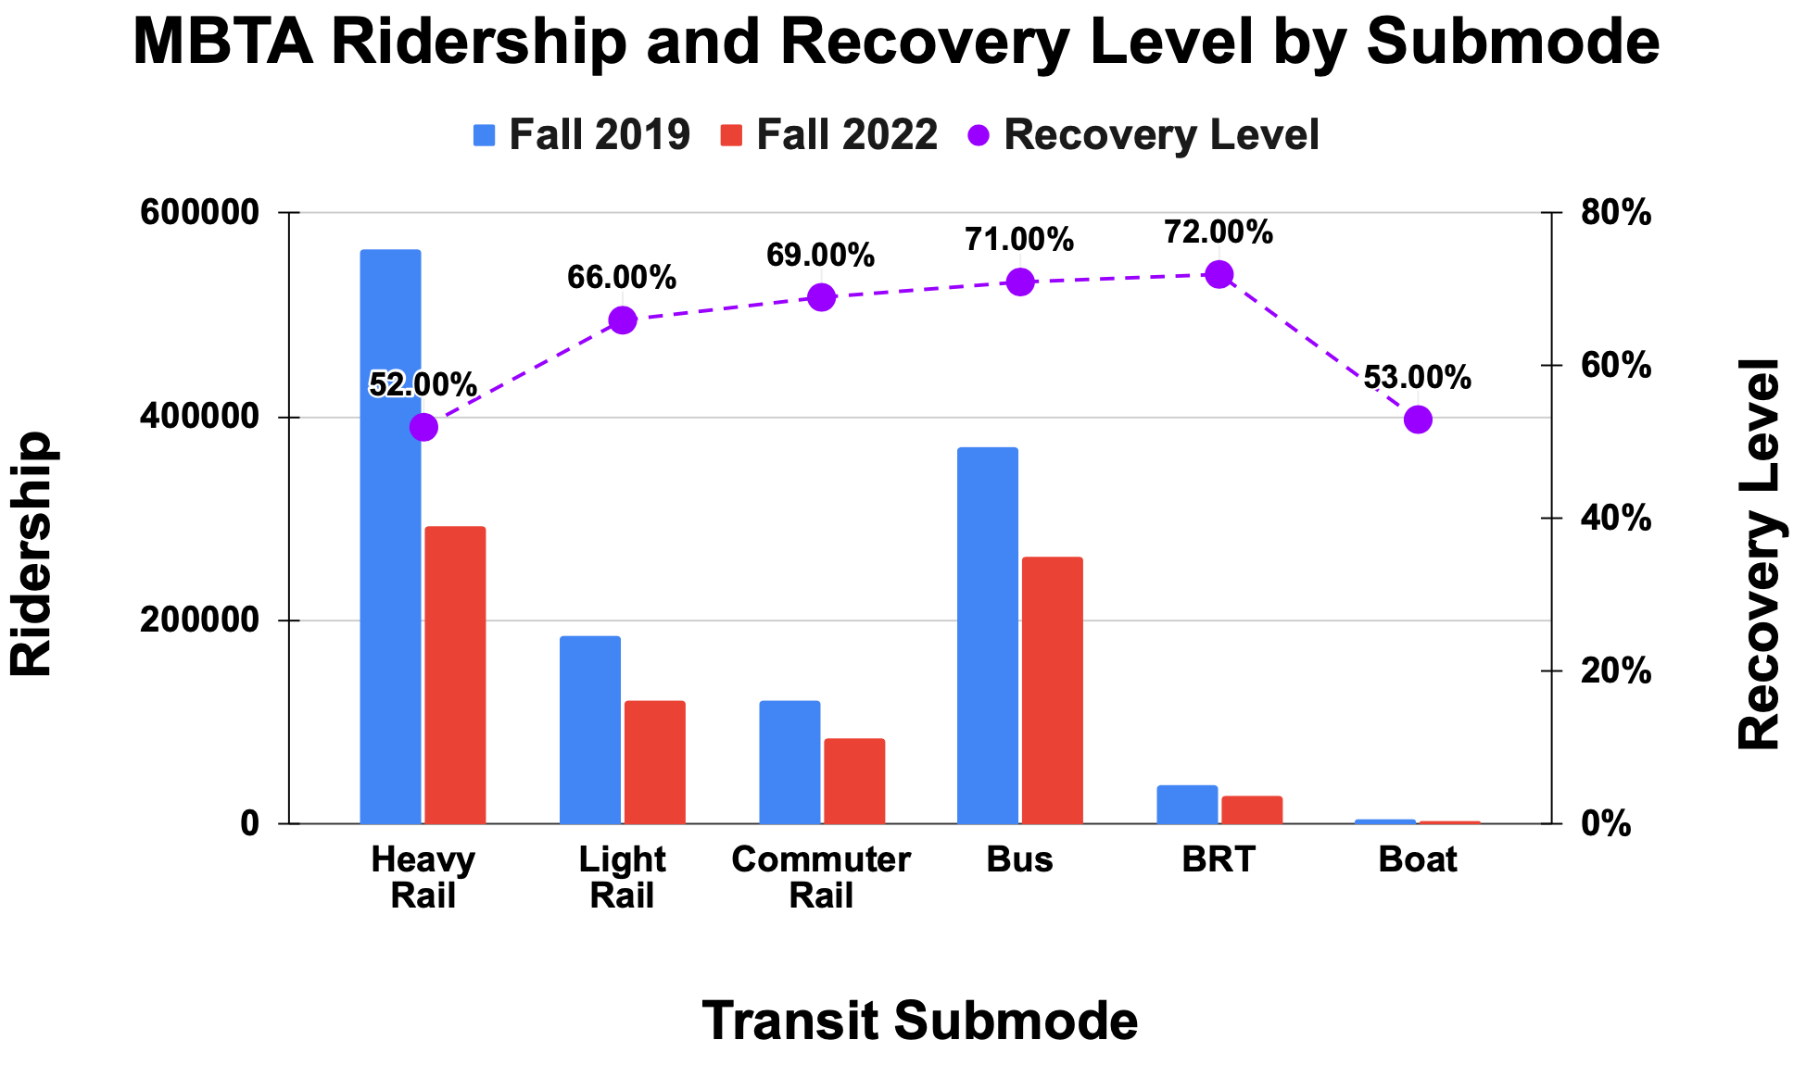

Motivation
Post-pandemic travel patterns
TDM23 2019 base year
?
Source: MBTA

Slide 4
Motivation
Post-Pandemic Travel Patterns
Big Data Platforms (REPLICA)
Inform Calibration Process
Activation
Work-From-Home in TDM23
Captures Travel Patterns?

Slide 5
Key Questions
How have mobility patterns shifted in the post-pandemic era?
To what extent is Replica data valid and effective for calibrating TDM23?
Does activating TDM23’s WFH component adequately reflect post-pandemic travel behavior?

Slide 6




Data Sources
TDM23
Replica
Boston Region’s Travel Demand Model
Big Data Fusion Platform
MBTA
HPMS
Massachusetts Bay Transportation Authority
Highway Performance Monitoring System

Slide 7
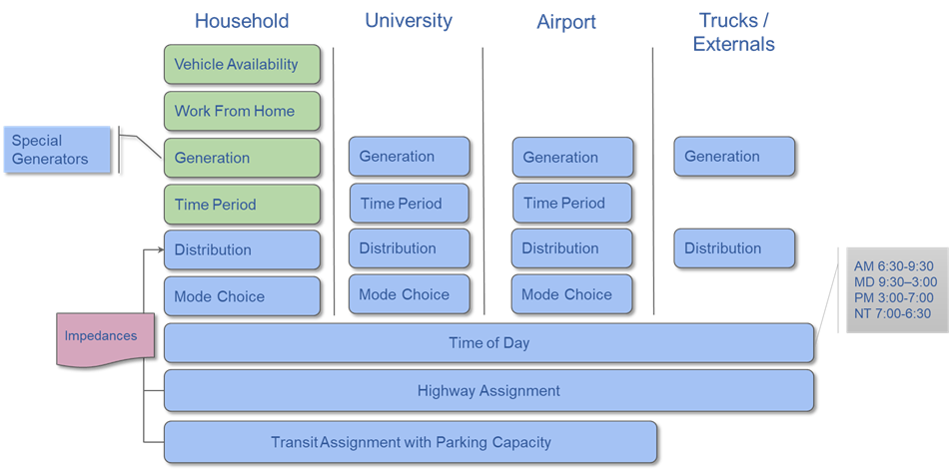
Data Sources: TDM23

Slide 8
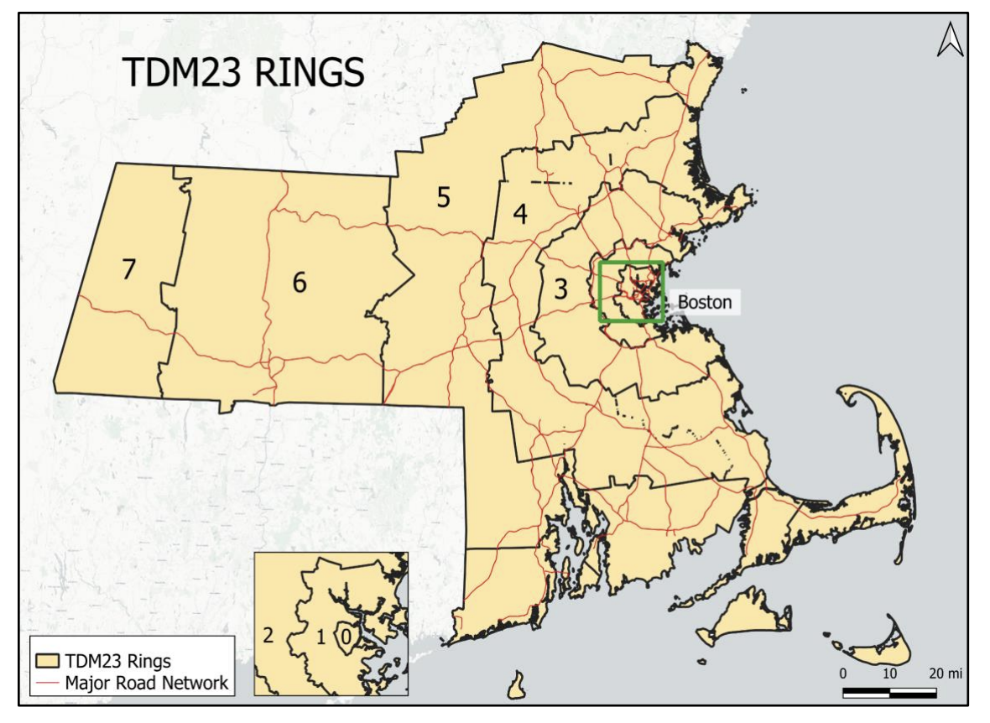
Data Sources: TDM23

Slide 9
Data Sources: REPLICA
Activity-based Model Simulates daily travel patterns for individuals
Inputs
Outputs
User Can Select
Mobile location data
OD Pairs
Consumer/resident data
Region
Trip Purpose
Built environment data
Season: Fall or Spring
Traffic Flows
Economic activity data
Day Type:
Weekday or Weekend
Mode Share
Ground truth data
Time of Day

Slide 10
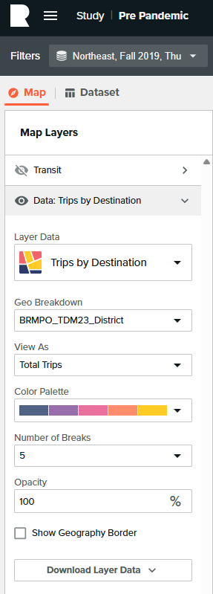
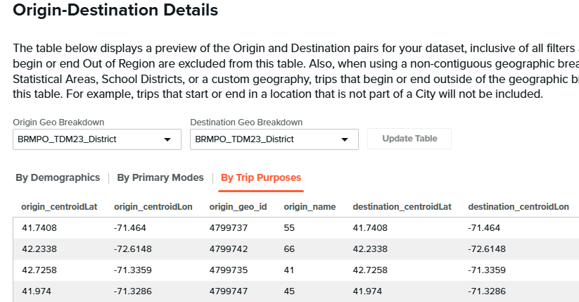
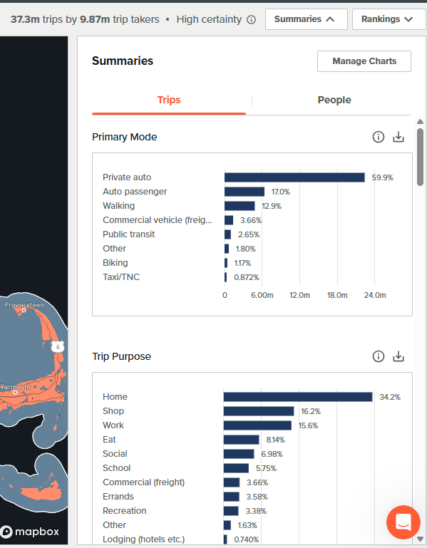
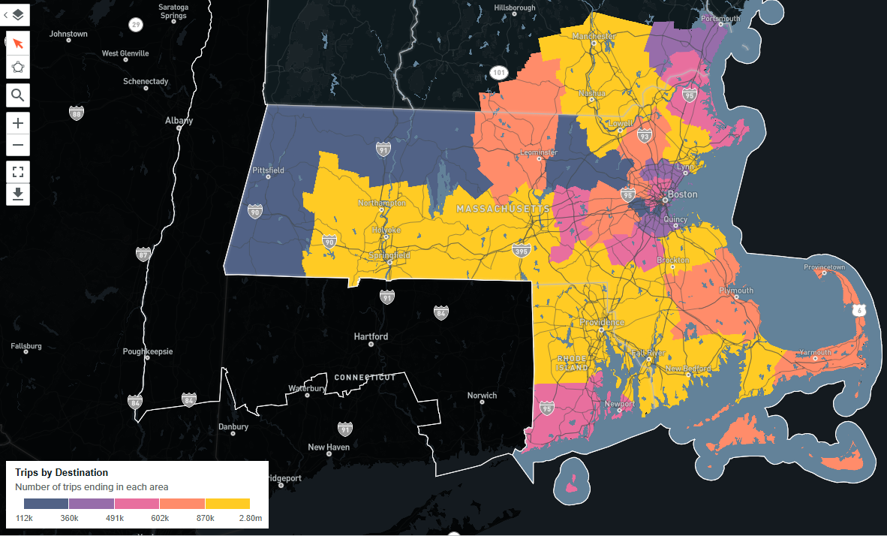
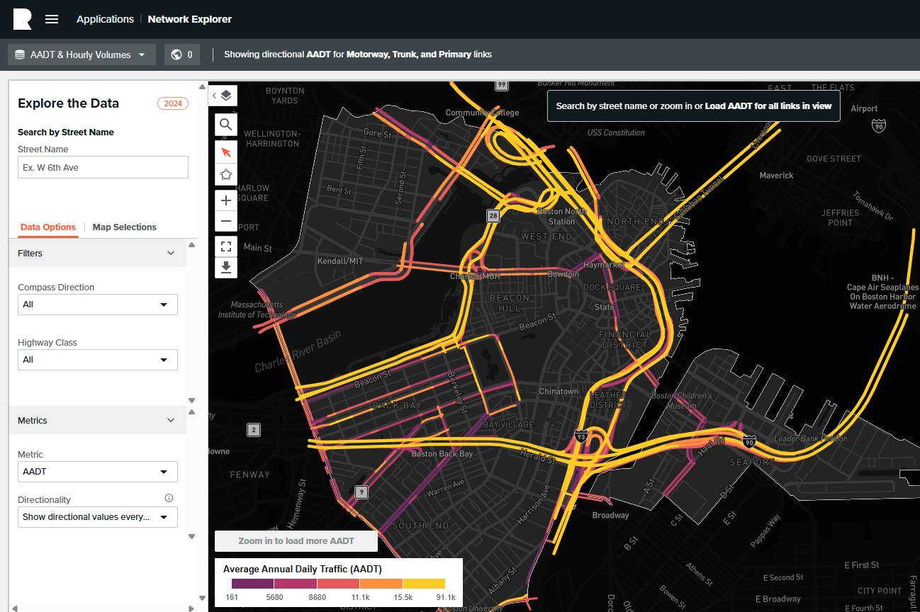

Slide 11

Methodology (Big Data Analysis)
Fall 2019
Trip Generation
Trip Distribution
Mode Choice
Highway Assignment
Big Data
Platform
Fall 2022
Perform Reasonableness Checks

Slide 12
Methodology (Big Data Analysis)
Model Component | Expected Changes in REPLICA
Trip Generation | Decrease in work related trips Increase in non-work related trips
Trip Distribution | Lower share of work trips to CBD Higher share of non-work trips to outer rings
Mode Choice | Lower transit share
Highway Assignment | Lower VMTs
Caros, N., Guo, X., Zheng, Y., and Zhao, J. (2023). The impacts of remote work on travel: Insights from nearly three years of monthly surveys. https://doi.org/10.48550/arXiv.2303.06186. Massachusetts Department of Transportation. (2024). Impact of teleworking:
Evaluating travel and economic effects for the Commonwealth.
https://www.mass.gov/doc/impact-of-teleworking-evaluating-travel-and-economic-effects-for-the-commonwealth

Slide 13
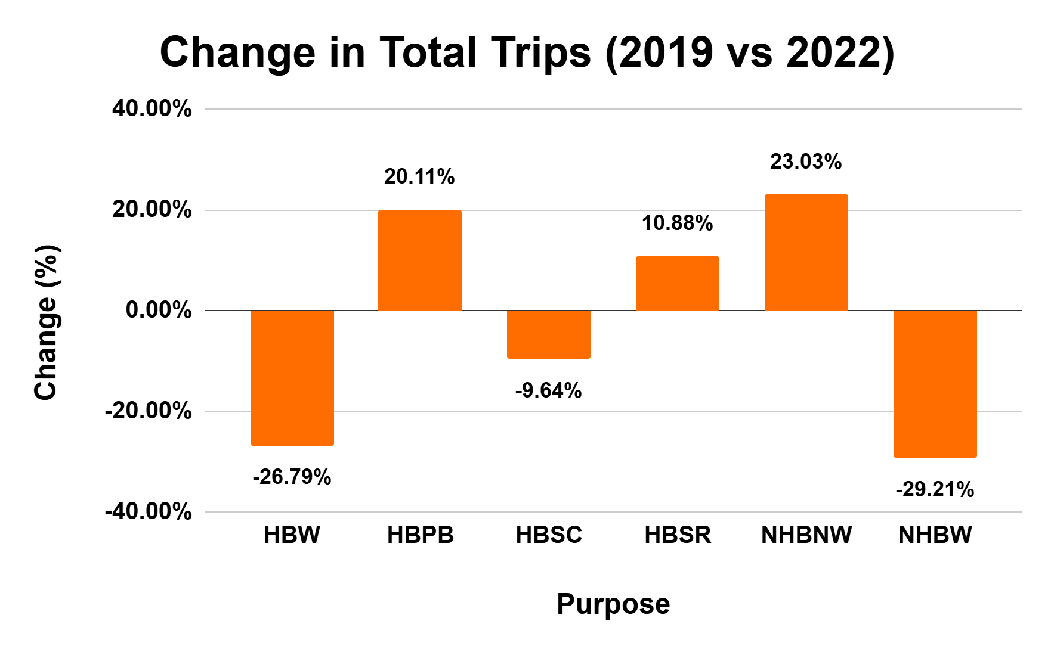
Trip Generation (REPLICA)
Purpose | Description
HBW | Home-Based Work
HBPB | Home-Based Personal Business
HBSC | Home-Based School
HBSR | Home-Based Social Recreation
NHBNW | Non-Home-Based Non-Work
NHBW | Non-Home-Based Work
Source: Replica

Slide 14
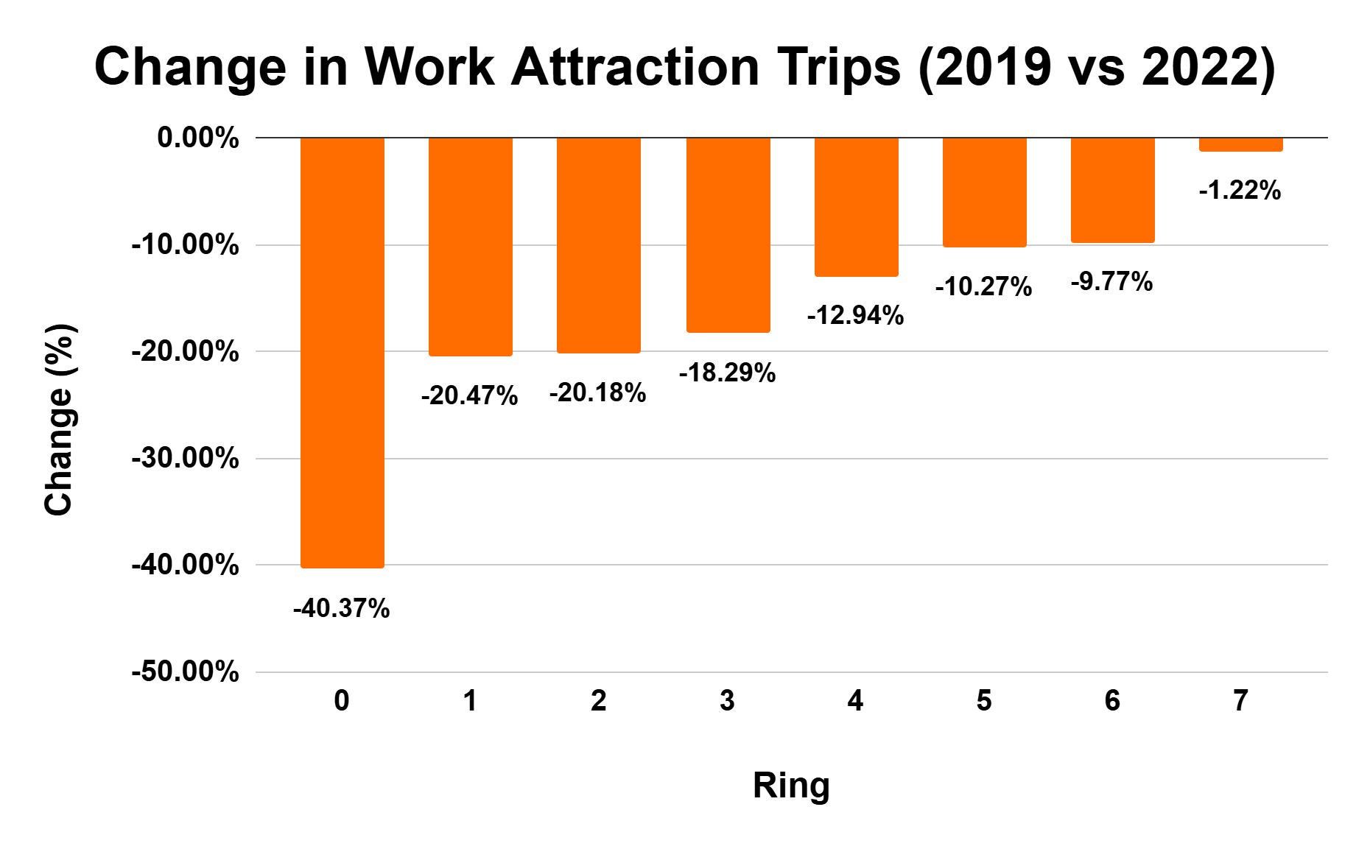
Trip Distribution (REPLICA)
Source: Replica

Slide 15
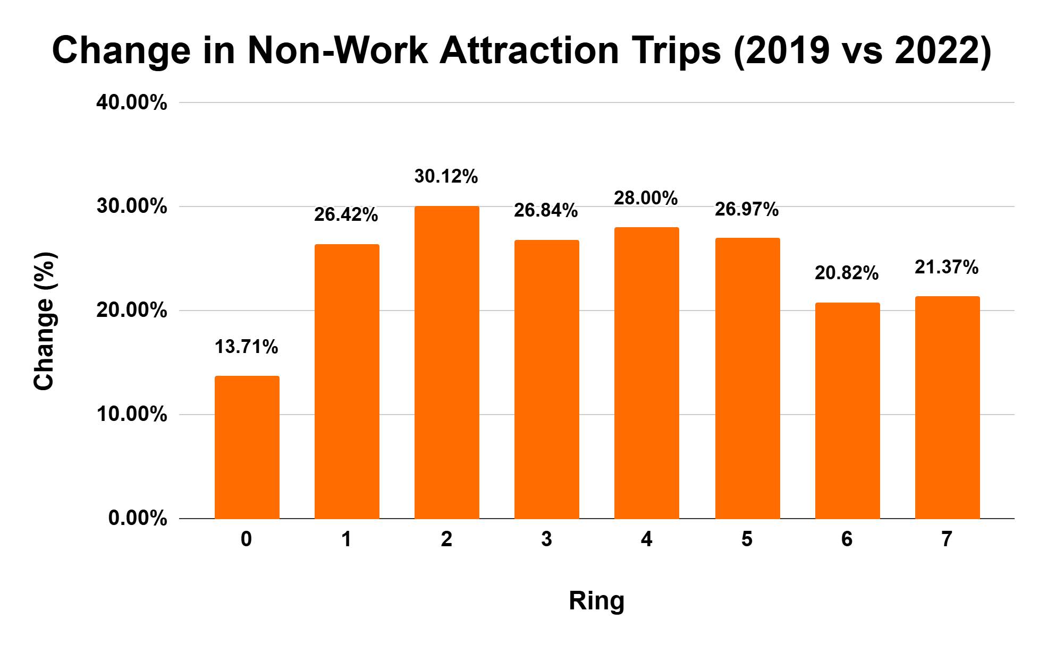
Trip Distribution (REPLICA)
Source: Replica

Slide 16
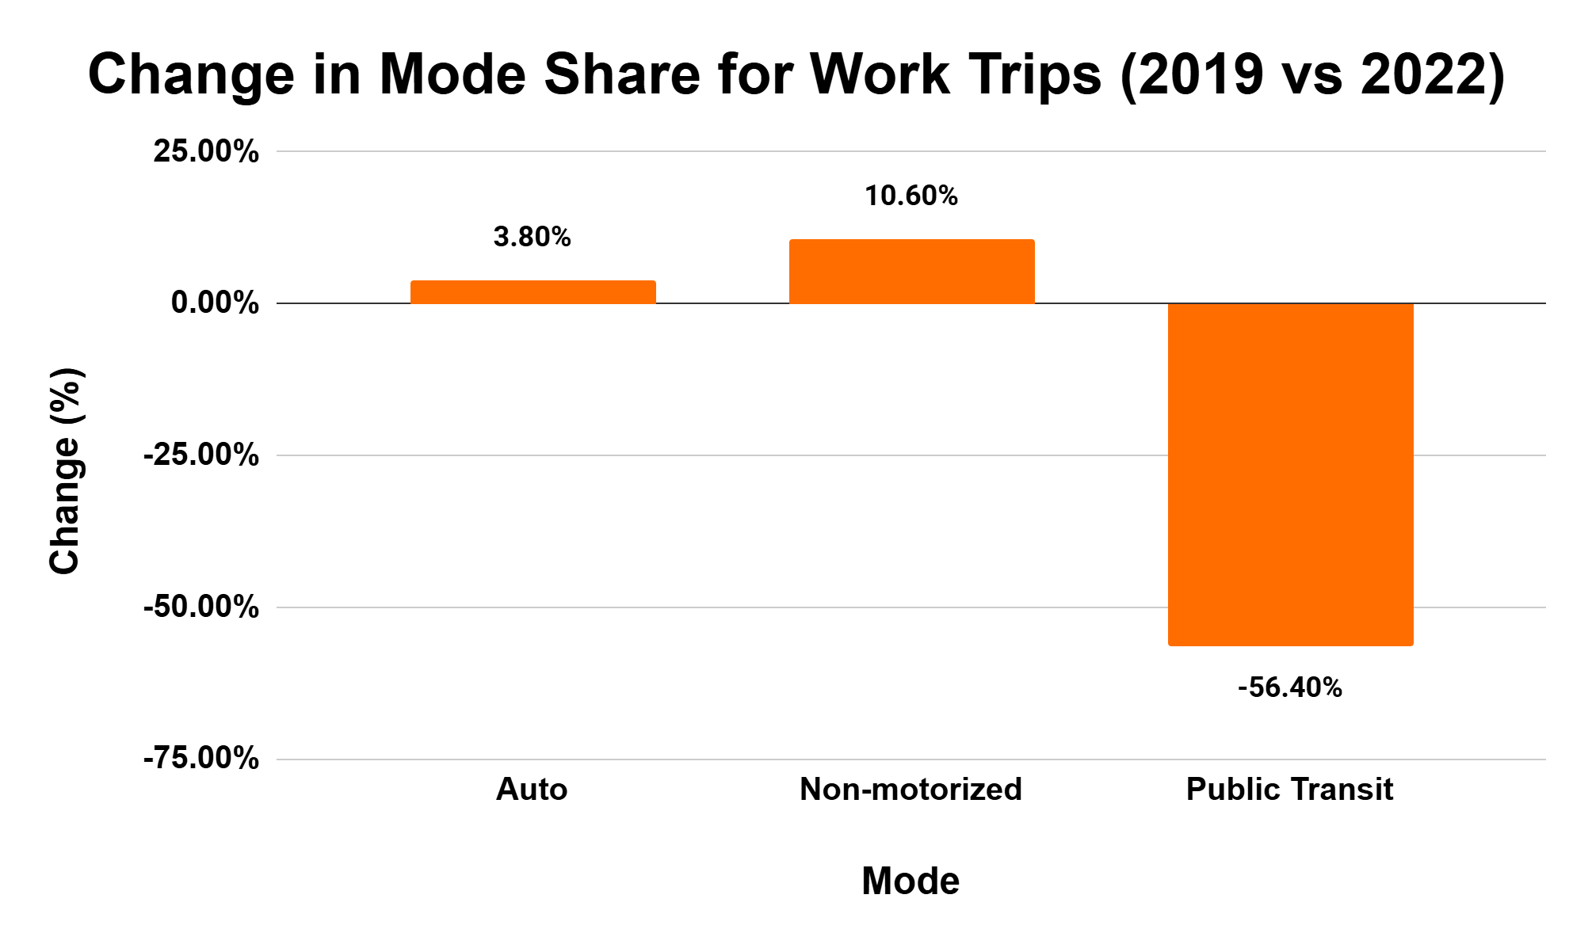
Mode Choice (REPLICA)
Source: Replica

Slide 17
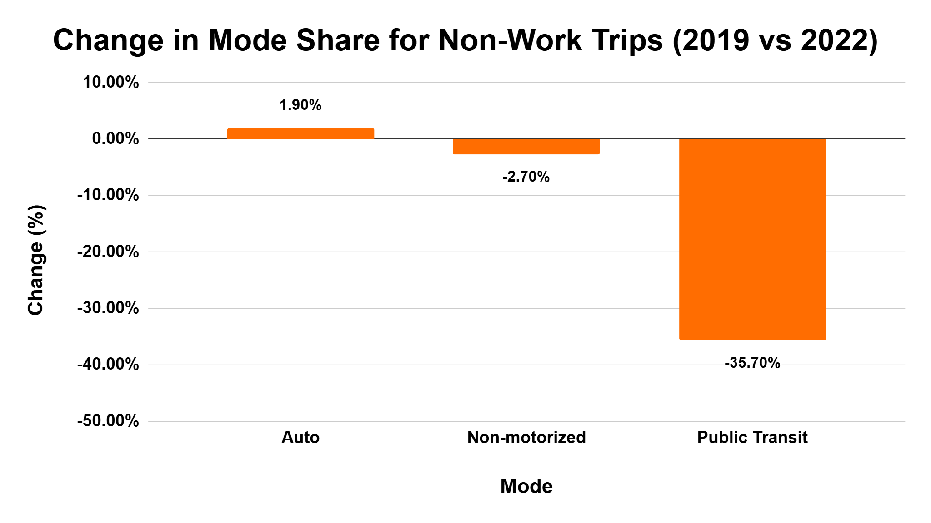
Mode Choice (REPLICA)
Source: Replica

Slide 18
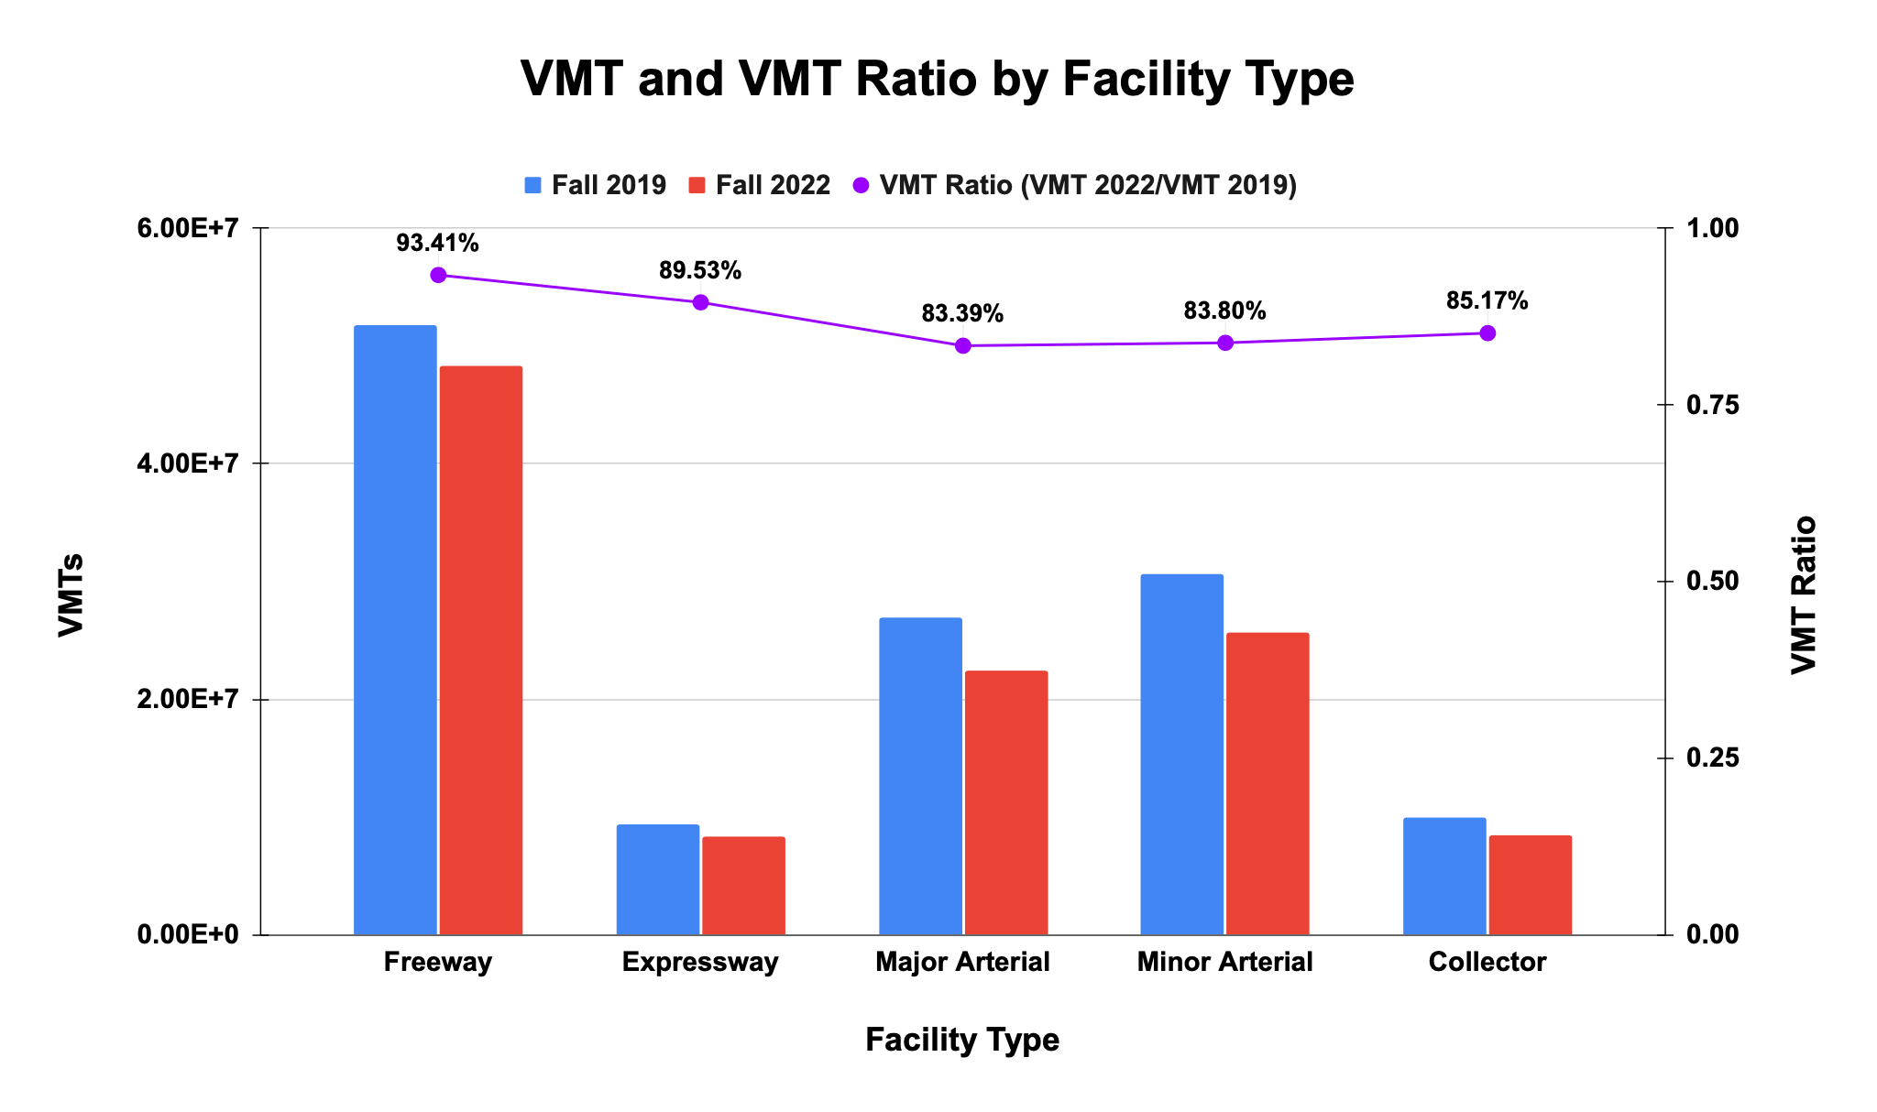
Highway Assignment (REPLICA)
Source: Replica

Slide 19
Methodology (WFH Testing)
Work-From-Home Activation
Summary and Validation Reports Checks
Replica and Observations Comparison
Work-From-Home Evaluation

Slide 20
WFH (Workers & Employment)
Regional Default WFH Rate | 0.21
MPO | Different from Regional Default | WFH Rate
BRMPO | X | 0.25
BRPC | X | 0.05
CCC | X | 0.1
CMRPC
FRCOG | X | 0.13
MRPC
MVC | X | 0.1
MVPC
NMCOG
NPEDC | X | 0.02
OCPC | X | 0.24
PVPC
SRPEDD
Job Sector Code | WFH Rate
1_constr | 0.08
2_eduhlth | 0.18
3_finance | 0.39
4_public | 0.32
5_info | 0.43
6_ret_leis | 0.1
7_manu | 0.2
8_other | 0.08
9_profbus | 0.35
10_ttu | 0.12
State | Different from Regional Default | WFH Rate
MA
NH
RI | X | 0.16
Source: Replica

Slide 21
Trip Generation
Productions
 | TDM23 |  |  | Replica (2019 vs 2022)
Purpose | NO WFH | WFH | Change (%)
HBW | 6,614,267 | 5,187,203 | -21.58% | -26.79%
HBPB | 8,283,843 | 8,283,843 | 0.00% | 20.11%
HBSC | 2,064,901 | 2,064,901 | 0.00% | -9.64%
HBSR | 7,620,362 | 7,620,362 | 0.00% | 10.88%
NHBNW | 9,387,685 | 9,387,685 | 0.00% | 23.03%
NHBW | 1,786,076 | 1,401,077 | -21.56% | -29.21%
Source: TDM23, Replica

Slide 22
Trip Generation
Attractions
 | TDM23 |  |  | Replica (2019 vs 2022)
Purpose | NO WFH | WFH | Change (%)
HBW | 6,573,843 | 5,212,135 | -20.71% | -26.79%
HBPB | 8,285,785 | 7,854,617 | -5.20% | 20.11%
HBSC | 1,119,388 | 1,119,388 | 0.00% | -9.64%
HBSR | 7,008,437 | 6,676,424 | -4.74% | 10.88%
NHBNW | 9,009,416 | 8,409,368 | -6.66% | 23.03%
NHBW | 1,732,248 | 1,457,185 | -15.88% | -29.21%
Source: TDM23, Replica

Slide 23
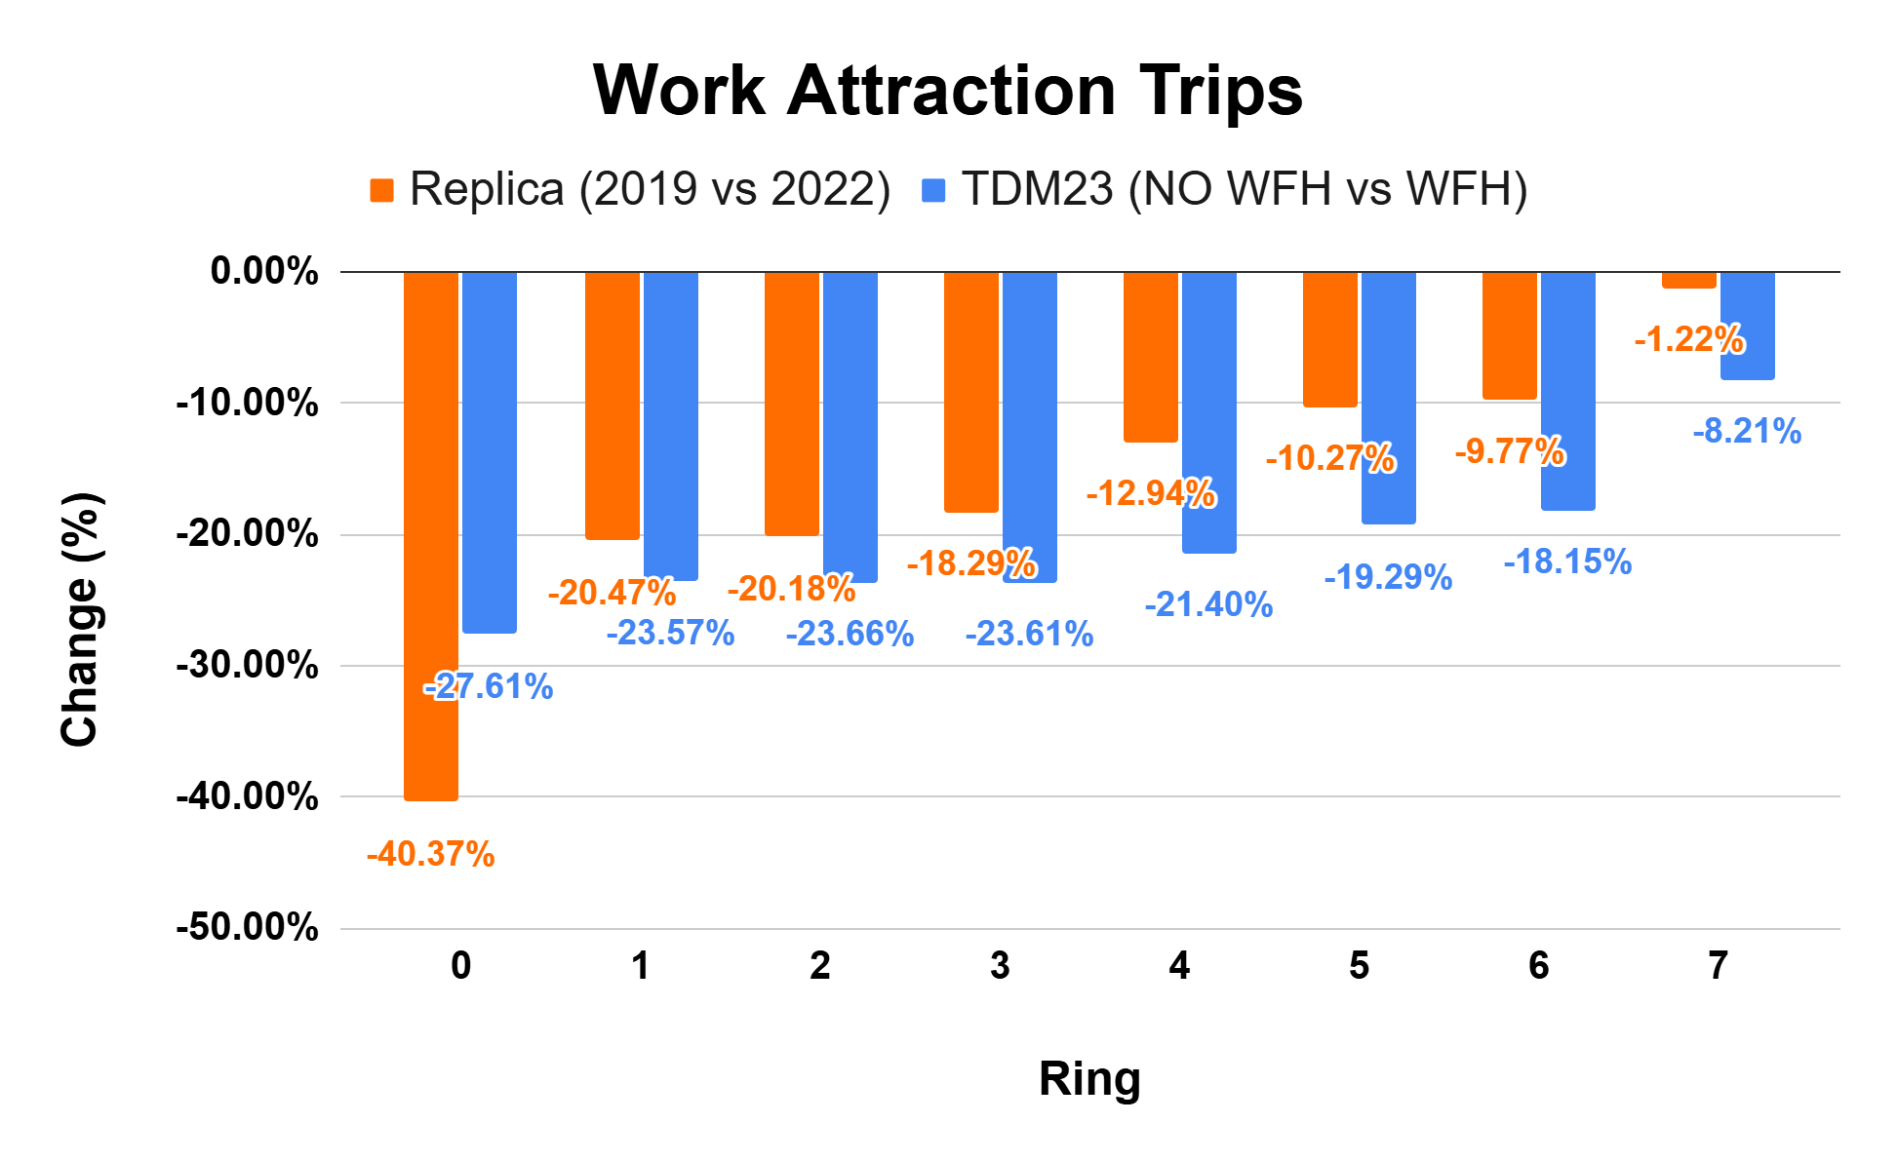
Trip Distribution
Source: TDM23, Replica

Slide 24
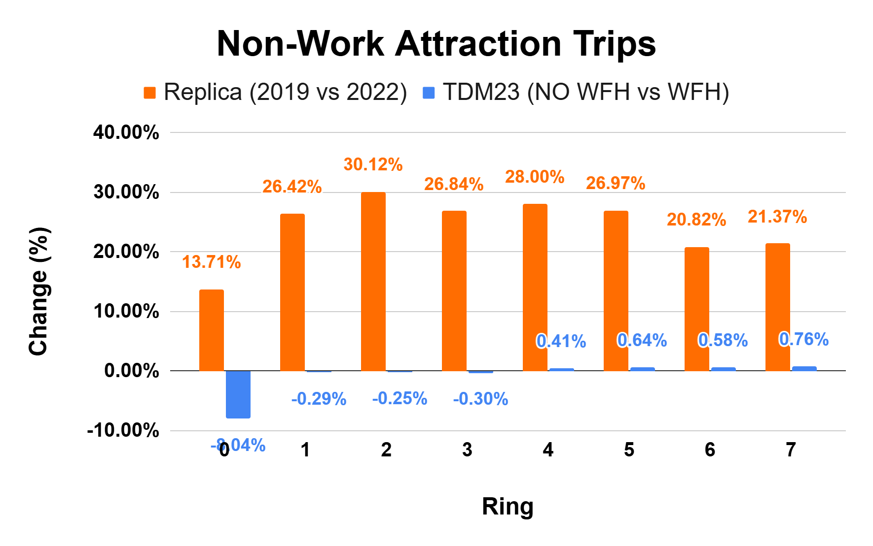
Trip Distribution
Source: TDM23, Replica

Slide 25
Mode Choice
 | TDM23 |  |  | Replica Change (2019 -> 2022)
Mode | No WFH | WFH | Change (%)
Auto | 86.20% | 86.52% | 0.4% | 2.00%
Non-motorized | 11.45% | 11.42% | -0.2% | 3.10%
Public Transit | 2.36% | 2.05% | -13.0% | -51.20%
Source: TDM23, Replica

Slide 26
Mode Choice
 | TDM23 |  |  | Replica Change (2019 -> 2022)
Mode | No WFH | WFH & -1 ASC Transit | Change (%)
Auto | 86.20% | 87.28% | 1.26% | 2.00%
Non-motorized | 11.45% | 11.75% | 2.64% | 3.10%
Public Transit | 2.36% | 0.97% | -58.83% | -51.20%
Source: TDM23, Replica

Slide 27
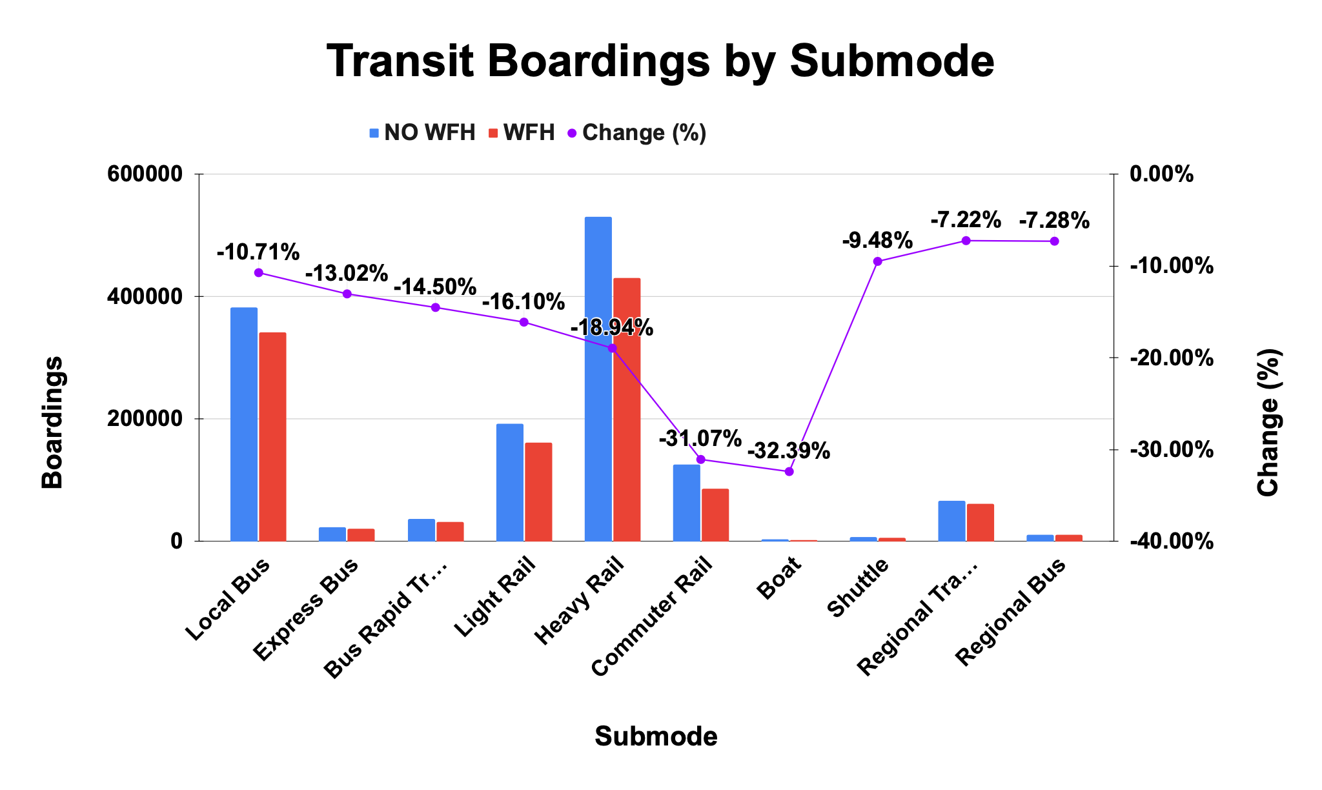
Transit Assignment
Source: TDM23

Slide 28
Transit Validation
Mode | MBTA 2022 Ridership | TDM23 (WFH) |  | TDM23 (WFH & -1 ASC Transit)
 |  | Ridership | Difference (%) | Ridership | Difference (%)
Bus | 261,938 | 440,375 | 68.1% | 194,023 | -25.9%
BRT | 37,981 | 31,627 | -16.7% | 14,244 | -62.5%
Light Rail | 125,667 | 161,856 | 28.8% | 78,518 | -37.5%
Heavy Rail | 292,978 | 430,438 | 46.9% | 211,777 | -27.7%
Comm. Rail | 84,004 | 86,697 | 3.2% | 40,551 | -51.7%
Boat | 3,259 | 2,009 | -38.4% | 1,099 | -66.3%
Source: TDM23, MBTA

Slide 29
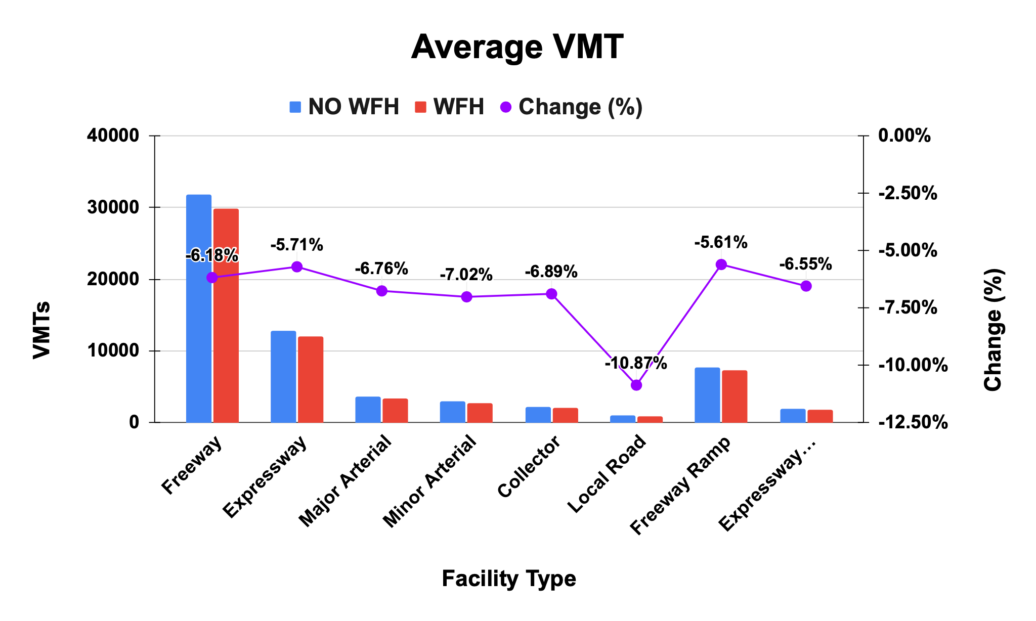
Highway Assignment
Source: TDM23

Slide 30
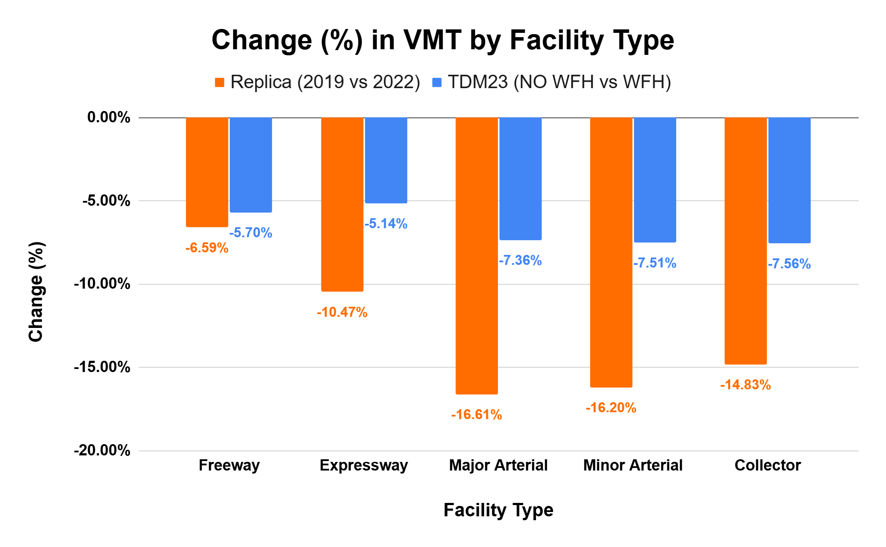
Highway Validation
Source: TDM23, Replica

Slide 31
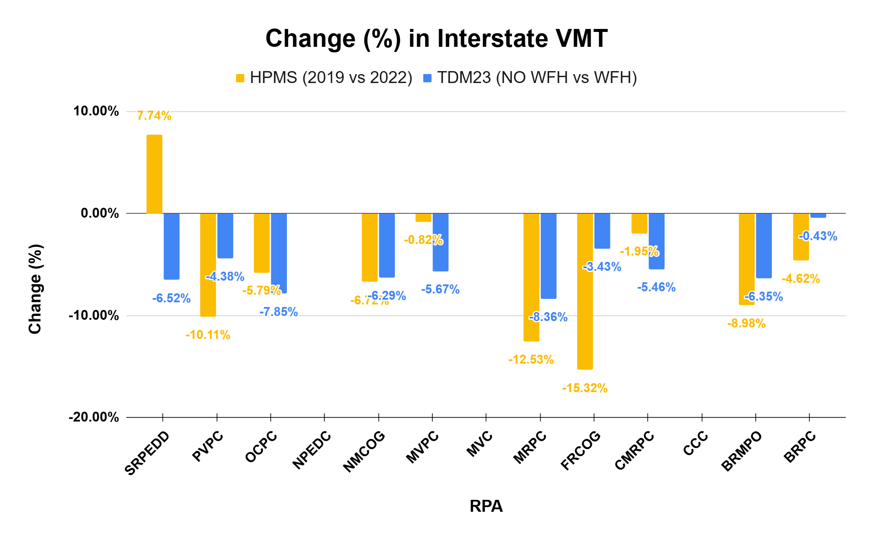
Highway Validation
Source: TDM23, HPMS

Slide 32
Conclusions
Post-Pandemic Travel Shifts
Decline in work trips, especially to CBD
Increase in local non-work trips
Decrease in transit mode share and VMTs
Big Data Platform Insights
Helps bridge gaps and highlight high level shifts
Use cautiously due to model architecture differences
WFH Activation Findings
Improves results
But not sufficient alone to explain full post-pandemic behavior

Slide 33
Thank you!
pcharitatos@ctps.org
dhan@ctps.org
model.support@ctps.org

